Slide 1


ANOMALY DETECTION AND EVENT PREDICTION USING SENSOR NETWORKS
CONFIDENTIAL: The information in this document belongs to Boston Institute of Analytics LLC. Any unauthorized sharing of this
material is prohibited and subject to legal action under breach of IP and confidentiality clauses.

Slide 2
PROBLEM STATEMENT
The goal of this project is to develop a comprehensive Anomaly Detection and Event Prediction system aimed at significantly enhancing monitoring capabilities within sensor networks. This system will enable proactive responses to potential issues, ultimately revolutionizing sensor network technology. The system should offer actionable insights to optimize resource allocation and operational efficiency.

Slide 3
INTRODUCTION
Anomaly detection is a crucial task in sensor networks to identify unusual patterns that may indicate faults or malicious activities.
This project focuses on developing a system for anomaly detection and event prediction in sensor networks, aiming to enhance system reliability and security.

Slide 4
METHODOLOGY
Gain insights into the data, including its distribution, characteristics, and patterns.
Use charts and plots (like histograms, scatter plots, box plots) to visualize data distributions and identify potential anomalies.
Requires labeled data. Examples include classification models like decision trees, SVMs, and neural networks.
Use appropriate metrics like precision, recall, F1-score, ROC-AUC, and confusion matrix to evaluate the model.

Slide 5
DATASET DESCRIPTION
The dataset consists of sensor data collected from various nodes in a sensor network. It comprises five features:
Area
Sensing Range
Transmission Range
Number of Sensor Nodes
Number of Barriers

Slide 6
DATA PREPROCESSING
Data Preprocessing Steps:
Handling missing values, duplicates, and outliers.
Feature scaling for standardization.
Standardization ensures that all features have a similar scale, preventing certain features from dominating the analysis.

Slide 7
EXPLORATORY DATA ANALYSIS
Exploratory Data Analysis (EDA) helped us understand the data structure, find patterns, identify trends, and gain valuable insights from the dataset.
From EDA we analyze, the distribution of each features, checking the correlation between the features .
The datasets is clean, as there is no NULL VALUE, but we can find some DUPLICATE VALUES and OUTLIERS.
We used several approaches to gain insights into individual characteristics of the data and likewise how each feature relates to main goal predicting the target variable.

Slide 8
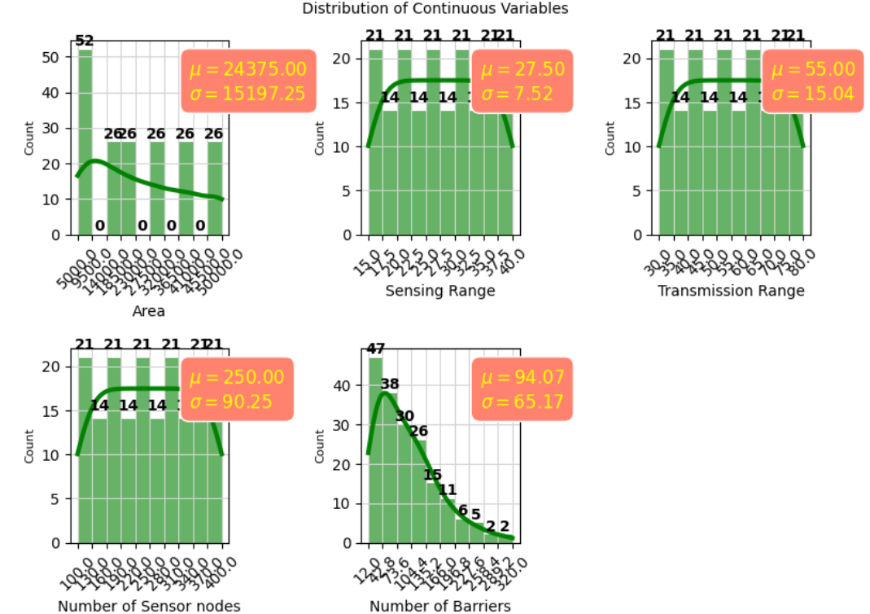
DISTRIBUTION OF CONTINUOUS VARIABLE

Slide 9
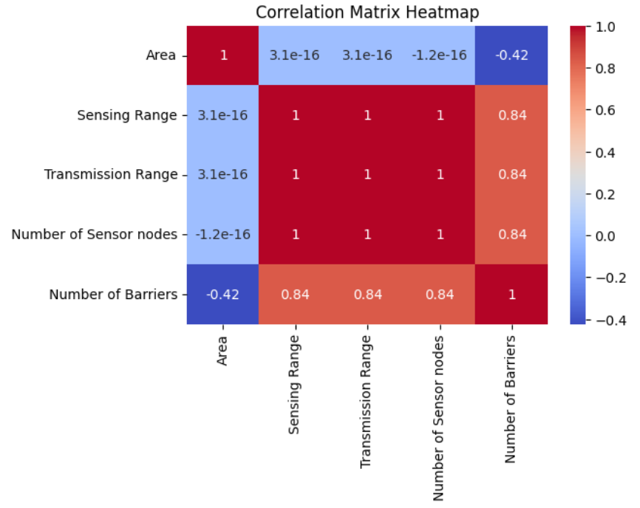
CORRELATION HEATMAP

Slide 10
MODEL SELECTION
Logistic Regression: Logistic Regression is commonly used for binary classification problems. It's preferred because it provides a simple an efficient way to model the relationship between the independent variables and the probability of a certain outcome.
Decision Tree: Decision Tree algorithms are used for classification because they are simple, computationally efficient, and effective in handling high-dimensional data. Works best for categorical independent columns.
Support Vector Machine: SVM is a powerful supervised algorithm that works best on smaller datasets but on complex ones. It can be used for both regression and classification tasks but generally they work best in classification problems.
Random Forest Algorithm: Random Forest is a robust supervised algorithm suitable for both regression and classification tasks.

Slide 11
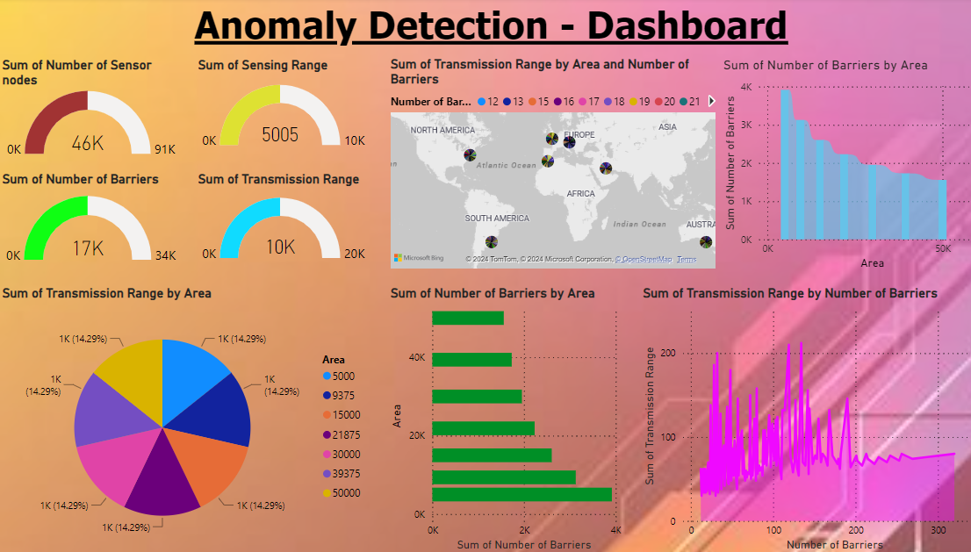
DATA VISUALIZATION

Slide 12
FUTURE SCOPE
Implementing anomaly detection algorithms directly on sensor devices to reduce latency and improve real-time processing capabilities.
Leveraging advanced machine learning algorithms to improve the accuracy and efficiency of anomaly detection.
Continued advancements in sensor technology, data analytics, machine learning, and computing power will further enhance the capabilities and impact of anomaly detection systems, contributing to safer, more efficient, and more sustainable practices in various fields.

Slide 13
ANY QUESTIONS?

Slide 14
THANK YOU!!!
CONFIDENTIAL: The information in this document belongs to Boston Institute of Analytics LLC. Any unauthorized sharing of this
material is prohibited and subject to legal action under breach of IP and confidentiality clauses.

